Slide 1
Geography of Pakistan
The Geographical layout of Pakistan

Slide 2
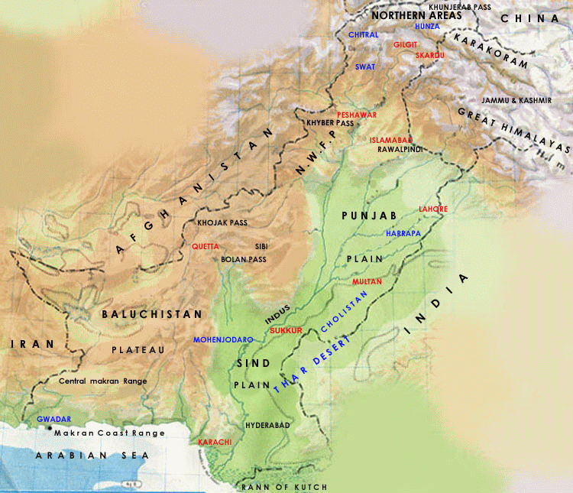

Slide 3
Major Features
Total area 796,095square km (803,940)
International Borders
India to its east, which has a 2,912 km (1,809 mile) border with Pakistan
To the west is Iran, with a 909 km (565 mile) border with Pakistan
To Pakistan's northwest lies Afghanistan, with a shared border of 2,430 km (1,510 miles)
China is towards the northeast and has a 523 km (325 mile) border with Pakistan
To the south is the Arabian Sea, with 1,046 km (650 mile) of coastline

Slide 4
A panhandle of Afghanistan territory in the northwest, the Wakhan Corridor, separates Pakistan and Tajikistan.
about 350 km long and 13–65 kilometers wide
Jammu and Kashmir is a disputed territory located between Pakistan and India.
Pakistan controls a portion of the territory as Azad (Free) Kashmir and the Northern Areas, while India controls a portion as the state of Jammu and Kashmir
Geo-Strategic Location

Slide 5
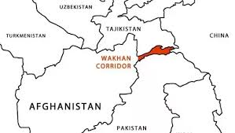

Slide 6
The variety of landscape divides Pakistan into five major regions
North High Mountainous Region
The Western Low Mountainous Region
The Baluchistan Plateau
The Pothohar Uplands
The Punjab and the Sindh Plains
Continuous massive mountainous tract in the north, the west and south-west and a large fertile plain, the Indus plain.
3/5 of the land is based on rough mountainous regions and plateaus
The remaining 2/5 constitutes a wide expanse of level plain

Slide 7
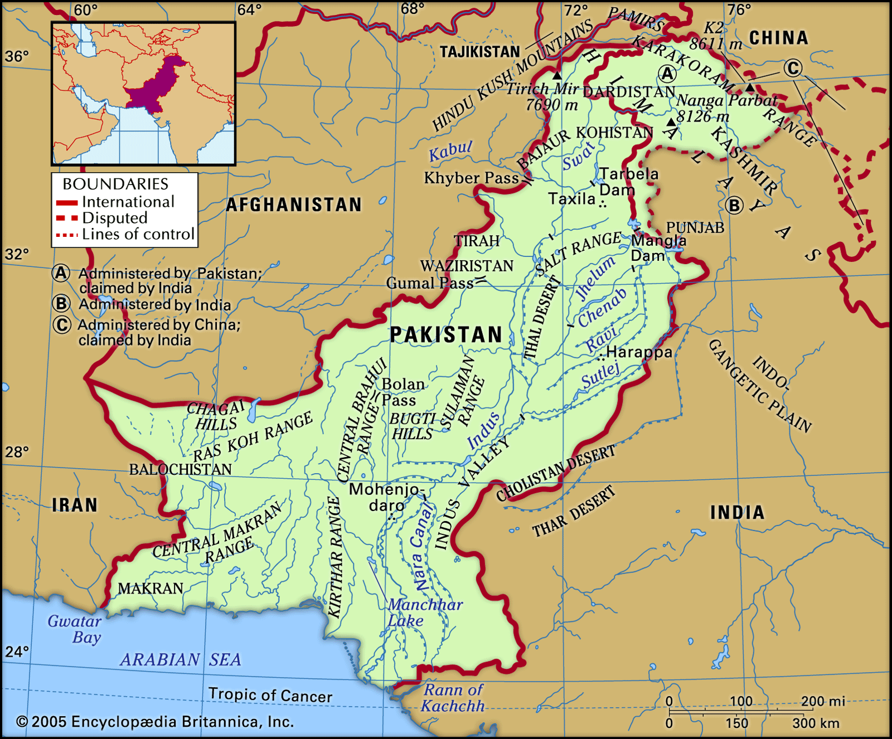

Slide 8
Mountains
The northern mountain system, comprising the Karakoram, the great Himalayas, and the Hindu-Kush, has enormous mass of snow and glaciers and 100 peaks of over 5,400 m. in elevation. K-2 ( the second highest peak in the world)
Hindu Kush: Pakistan and Afghanistan Highest point Tirich Mir (25,289 ft)
Karakorum Range: Pakistan, India, China borders Includes K2 Karakorum highway Connects Gilgit with Xinjiang
Himalayas: Pak, India, China, Nepal, Bhutan Indus river arise in the Himalayas. Mount Everest (Nepal and China)

Slide 9
The western mountain ranges, not so high as in the north, comprise the
Sufed Koh: south of the Kabul River and forming a border with Afghanistan. spread over Kohat district, Khyber Pakhtunkhwa
Sulaiman Range: south of Gumal river, The Sulaiman Range tapers into the Marri and Bugti hills in the south

Slide 10
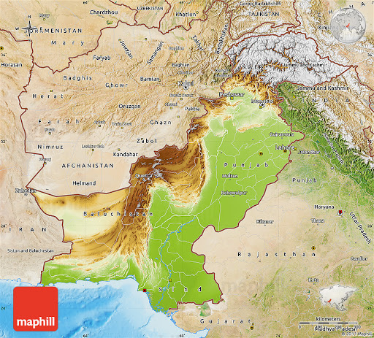

Slide 11
Plateaus (A large flat area of land that is higher than the land around it)
The Baluchistan plateau: variety of features Mountains, Plateaus and Basins (an area of land that is lower at the center than at the edges, especially one from which water runs down into a river)
Basins of North Baluchistan: Zhob Basin and Loralai Basin
Present between Tobba Kakr Ranges and Suleman Ranges
Quetta valley
Basins of Western Baluchistan
Inland Basin (no outlet to the sea)
Present between Chaghi hills and Ras koh in the west, Kirther in East and Siahan Range, Central Makran Range in the south
Dessert in North west Baluchistan , Kharan
Coastal Areas: Makran coastal area and Lasbela
Rich in Natural Resources

Slide 12
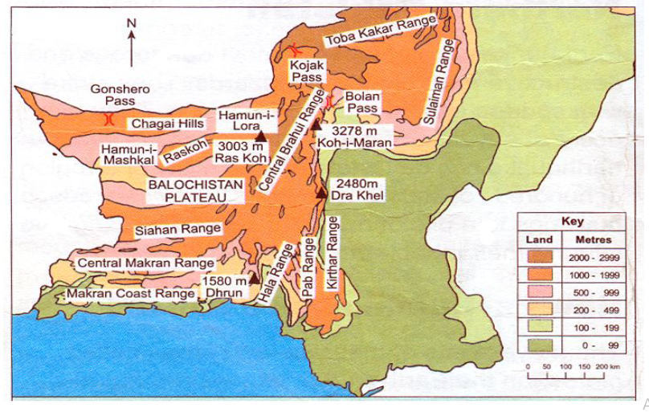

Slide 13
Pothwar Plateau:
The average height is about 300 to 600meters
It is located Northwest side of the Punjab Province and covers the area of 18000km2
Its northern boundary is formed by Kala Chitta ranges and Margalla Hills, south side by salt ranges, eastern side by River Jhelum and western by River Indus
The plateau cover the districts of Rawalpindi, Jhelum, Attok and Chakwal.
River Soan, Korang, Harro, Sill and Dharab are the main water bodies of the area.
Rock salt, Limestone, Gypsum, oil, Coaland Gas are the main minerals of the plateau.

Slide 14
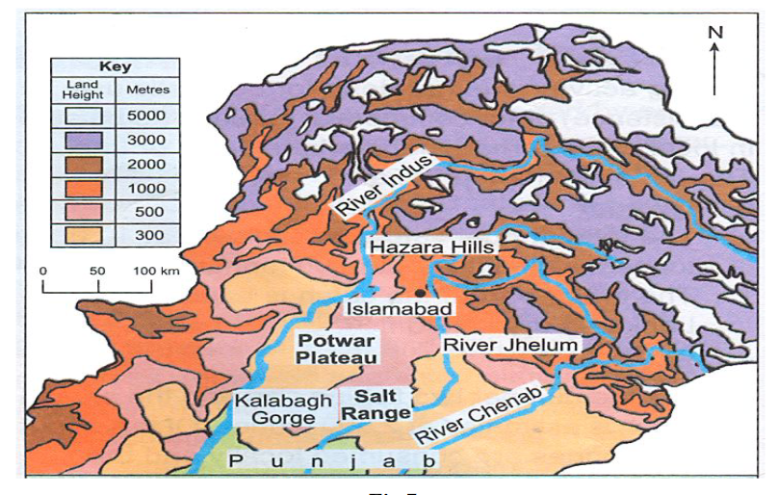

Slide 15
Plains
The Upper Indus Plain
From the point of junction eastern tributaries of river Indus is known as the upper Indus Plain . It includes most of the areas of Punjab Province. The upper Indus Plain has a height from 600 feet to 1000 feet. The northeastern part is comparatively higher. Although most of the plain area has existed by the alluvial soil brought by the rivers, but near Sargodha, Chiniot and Sangal, some old dry hiss appear above the plain. These are known as [Kinara hills]. The five big rivers of Punjab drain this plain. The land that lies between the two rivers if known as [DOAB]. Thus the area of Punjab plain can be divided into following Doabs:
Bari Doab
The Rachna Doab
The Chaj Doab
The Sindh Sagar Doab

Slide 16
lower Indus Plains
Mithankot is known as junction of Indus river and its eastern tributaries. Beyond Mithankot River Indus flows alone and carries not only its own water, but also that of its eastern and western tributaries, while flowing \from the Province of Sindh, if becomes several miles wide especially during the flood season.
The river Indus flows very slowly and the silt carried by if is largely deposited on its bed, thereby raising it above the level of the sandy plain. The land on either side is, therefore, protected by the construction of embankments of bunds a number of difficulties has to be faced during floods season.
The Indus plain consists of the alluvial plain and sand-dunal deserts.

Slide 17
Much of the silt of the alluvial plain is from natural geological erosion of mountains in the north brought down by rivers.
Thal desert lies between the rivers Indus and Jhelum, while Cholistan and Thar deserts occur on the south-east of the country.

Slide 18
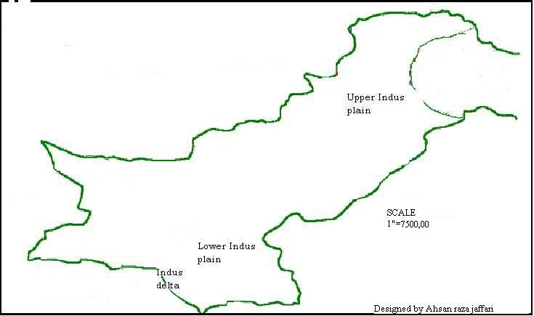

Slide 19
The Indus River
The Indus River that flows the length of Pakistan from north to south almost vertically divided the country into two halves. To the west of the Indus are the rugged dry mountains of the Sulaiman Range, which merge with the treeless Kirthar Range in the south. Farther west are the arid regions of the Balochistan Plateau and the Kharan Basin. A series of mostly barren low mountains and hills predominate in the western border areas. While that on left is mostly plains, lush green and fertile in the northern half and Thar Desert in the southeast that straddles the border with India.

Slide 20
The coastline of Pakistan extends 1,050 km (650 mi) along the Arabian Sea. Karachi, Ormarah, Pasni and Gwader are some of the important coastal areas. In addition to Karachi and Bin Qasim (some 40 km west of Karachi), a new sea port at Gwader is presently under construction with the Chinese assistance. Upon completion, it will serve as a major hub of economic activities for CARs. A naval base is also under construction at Ormarah. Thus the chain of seaports will greatly improve the living of fishermen living all along the coast. A coastal highway from Karachi to Gwader is also fast completing. The Makran Coast Range forms a narrow strip of mountains along about 75 percent of the total coast length, or about 800 km (500 mi). These steep mountains rise to an elevation of up to 1,500 m (5,000 ft).

Slide 21
There are some of the highest pinnacles of the world (at least five above 8,000 metres - including the K-2, the second highest after Mt Everest). The northern parts of the country receive more rainfall than the rest of the country and serve as the storage of huge water reservoirs to produce electricity and water for irrigation. However, generally Pakistan is a dry, sun-scorched region, and most parts of its southern regions are desert or semi desert areas. The area bordering with India in the south east is flat desert known as Cholistan or Thar Desert, which is known as the Rajhistan Desert on the other side of the border.

